Slide 1


LESSON 10
EXPONENTIAL and LOGARITHMIC FUNCTIONS

Slide 2
EXPONENTIAL FUNCTION
If x and b are real numbers such that b > 0 and b ≠ 1, then f(x) = b^{x} is an exponential function with base b.
Examples of exponential functions:
a) y = 3^{x} b) f(x) = 6^{x}
Example: Evaluate the function y = 4^{x} at the given values of x.
a) x = 2 b) x = -3 c) x = 0

Slide 3
PROPERTIES OF EXPONENTIAL FUNCTION y = b^{x}
The domain is the set of all real numbers.
The range is the set of positive real numbers.
The y – intercept of the graph is 1.
The x – axis is an asymptote of the graph.
The function is one – to – one.

Slide 4
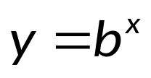
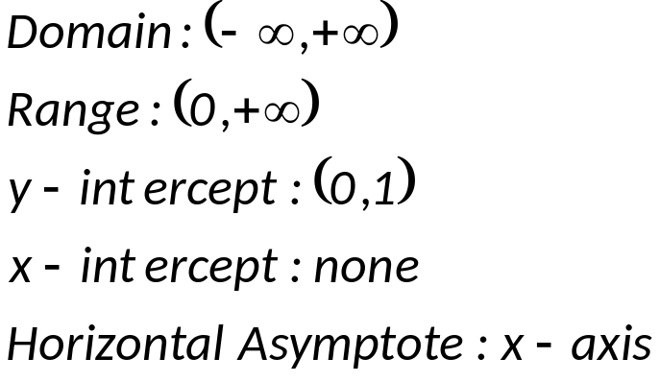

The graph of the function y = b^{x}
y
1
o
x

Slide 5

EXAMPLE 1: Graph the function y = 3^{x}
x | -3 | -2 | -1 | 0 | 1 | 2 | 3
y | 1/27 | 1/9 | 1/3 | 1 | 3 | 9 | 27
y
1
o
x

Slide 6
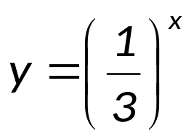
EXAMPLE 2: Graph the function y = (1/3)^{x}
x | -3 | -2 | -1 | 0 | 1 | 2 | 3
y | 27 | 9 | 3 | 1 | 1/3 | 1/9 | 1/27
y
1
o
x

Slide 7


EXAMPLE 3: Graph of the function y = 3^{x}
with translations
y
1
o
x

Slide 8
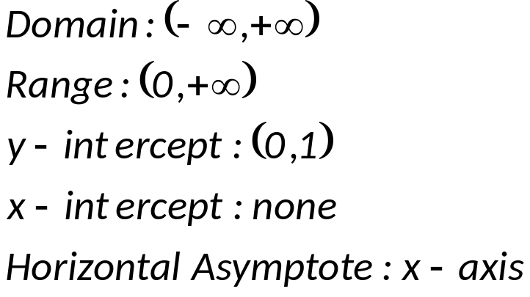

NATURAL EXPONENTIAL FUNCTION: f(x) = e^{x}
y
1
o
x

Slide 9
DEFINITION OF A LOGARITHM AND A LOGARITHMIC FUNCTION
If x > 0 and b is a positive constant (b ≠ 1), then
y = log_{b} x if and only if b^{y} = x
The notation log_{b} x is read “the logarithm (or log) base b of x”. The function defined by f(x) = log_{b} x is a logarithmic function with base b. This function is the inverse of the exponential function g(x) = b^{x}.
Examples of logarithmic functions:
a) y = log₃ x b) f(x) = log₆ x
Definition of Exponential Form and Logarithmic Form:
The exponential form of y = log_{b} x is b^{y} = x.
The logarithmic form of b^{y} = x is y = log_{b} x.

Slide 10
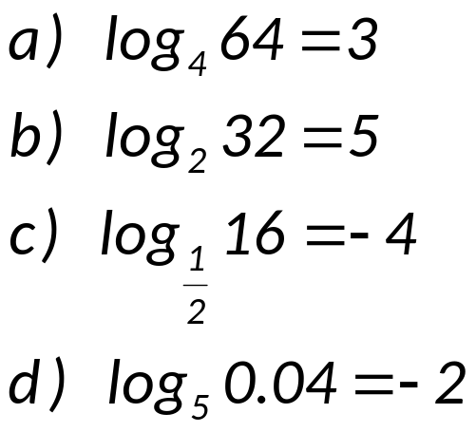
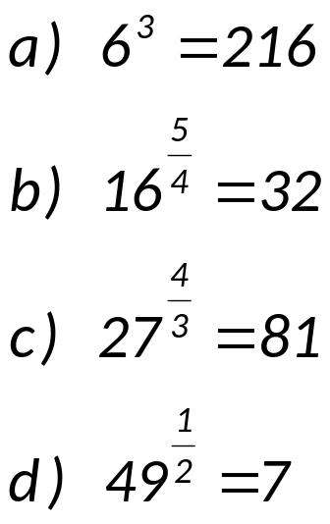
EXAMPLE 1: Express in exponential form:
EXAMPLE 2: Express in logarithmic form:

Slide 11
PROPERTIES OF LOGARITHMIC FUNCTIONS
The domain is the set of positive real numbers.
The range is the set of all real numbers.
The x – intercept of the graph is 1.
The y – axis is an asymptote of the graph.
The function is one – to – one.

Slide 12
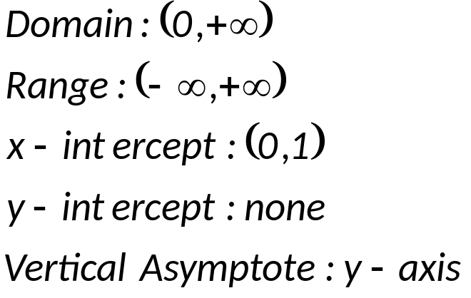

The graph of the function y = log_{b} x
y
o
x
1

Slide 13

EXAMPLE 1: Graph the function y = log₃ x
x | 1/27 | 1/9 | 1/3 | 1 | 3 | 9 | 27
y | -3 | -2 | -1 | 0 | 1 | 2 | 3
y
1
o
x

Slide 14
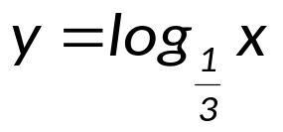
EXAMPLE 2: Graph the function y = log_{1/3} x
x | 27 | 9 | 3 | 1 | 1/3 | 1/9 | 1/27
y | -3 | -2 | -1 | 0 | 1 | 2 | 3
y
1
o
x

Slide 15


EXAMPLE 3: Graph the function y = log₃ x
with translations
y
1
o
x

Slide 16
DEFINITION OF COMMON AND NATURAL LOGARITHMS
The function defined by f(x) = log₁₀ x is called the common logarithmic function. It is customarily written as f(x) = log x, without stating the base.
The function defined by f(x) = log_{e} x is called the natural logarithmic function. It is customarily written as f(x) = ln x.

Slide 17
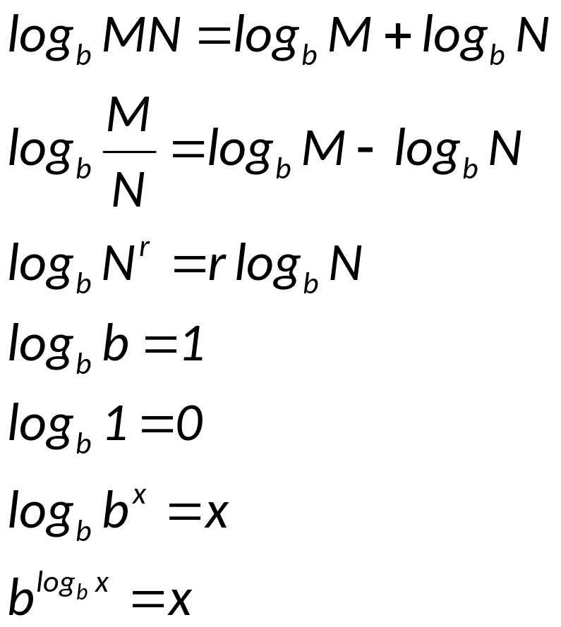
PROPERTIES OF LOGARITHMS
If M, N, and b (b ≠ 1) are positive real numbers, and r is any real number, then

Slide 18
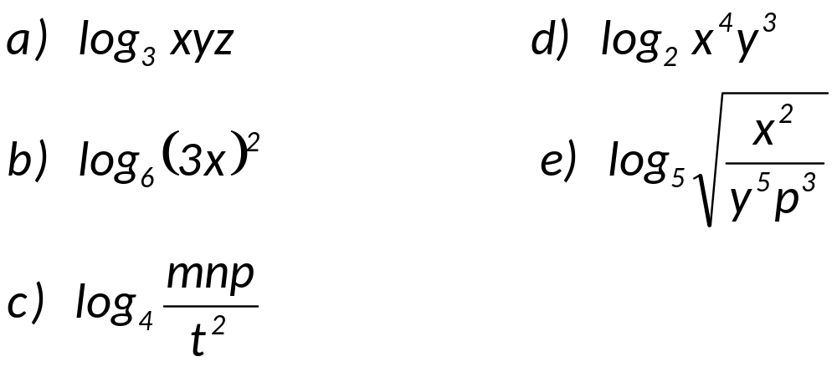
Since logarithmic function is continuous and one-to-one, every positive real number has a unique logarithm to the base b. Therefore,
log_{b}N = log_{b}M if and only if N = M
EXAMPLE 1: Express the ff. in expanded form:

Slide 19
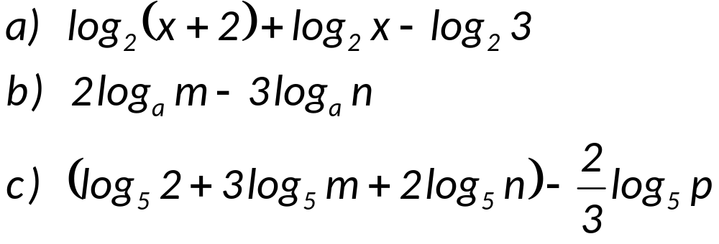
EXAMPLE 2: Express as a single logarithm:

Slide 20
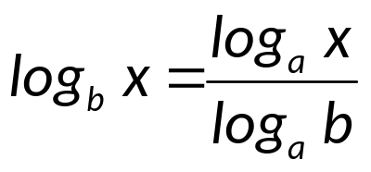
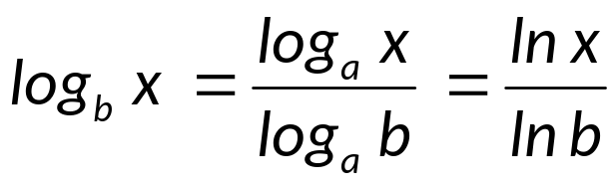
CHANGE-OF-BASE FORMULA
If x, a, and b are positive real numbers with a ≠ 1 and b ≠ 1, then
Because most calculators use only common logarithms (a = 10) or natural logarithms (a = e), the change-of-base formula is used most often in the following form.
If x and b are positive real numbers and b ≠ 1, then
EXAMPLE: Use common logarithms and natural logarithms to find each logarithm:

